Slide 1
security policy
What is a security policy?

Slide 2
What is a security policy?
A security policy is a document that states in writing how a company plans to protect its physical and information technology (IT) assets. Security policies are living documents that are continuously updated and changing as technologies, vulnerabilities and security requirements change.
A company's security policy may include an acceptable use policy. These describe how the company plans to educate its employees about protecting the company's assets. They also include an explanation of how security measurements will be carried out and enforced, and a procedure for evaluating the effectiveness of the policy to ensure that necessary corrections are made.

Slide 3
Why are security policies important?
Security policies are important because they protect an organizations' assets, both physical and digital. They identify all company assets and all threats to those assets.
Physical security policies are aimed at protecting a company's physical assets, such as buildings and equipment, including computers and other IT equipment. Data security policies protect intellectual property from costly events, like data breaches and data leaks.

Slide 4
Physical security policies
Physical security policies protect all physical assets in an organization, including buildings, vehicles, inventory and machines. These assets include IT equipment, such as servers, computers and hard drives.
Protecting IT physical assets is particularly important because the physical devices contain company data. If a physical IT asset is compromised, the information it contains and handles is at risk. In this way, information security policies are dependent on physical security policies to keep company data safe.

Slide 5
Information security policies
Protect valuable assets.
These policies help ensure the confidentiality, integrity and availability -- known as the CIA triad -- of data.
They are often used to protect sensitive customer data and personally identifiable information.

Slide 6
Guard reputations
Data breaches and other information security incidents can negatively affect an organization's reputation.

Slide 7
Ensure compliance with legal and regulatory requirements
Many legal requirements and regulations are aimed at security sensitive information.
For example, Payment Card Industry Data Security Standard dictates how organizations handle consumer payment card information.
Health Insurance Portability and Accountability Act details how companies handle protected health information.
Violating these regulations can be costly.

Slide 8
Dictate the role of employees
Every employee generates information that may pose a security risk.
Security policies provide guidance on the conduct required to protect data and intellectual property.Identify third-party vulnerabilities.
Some vulnerabilities stem from interactions with other organizations that may have different security standards.
Security policies help identify these potential security gaps.

Slide 9
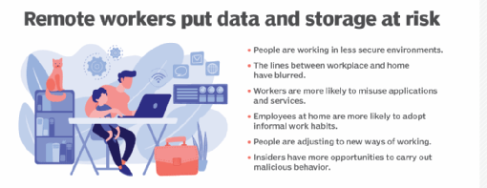
a list of the ways remote workers put data at risk

Slide 10
Types of security policies
Organizational
System-specific
Issue-specific

